Slide 1
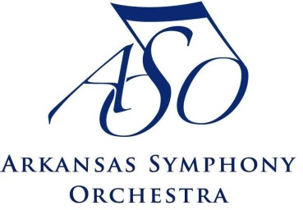

ASO Quapaw String Quartet
presents
American Road Trip
Arkansas
Learning through the Arts

Slide 2
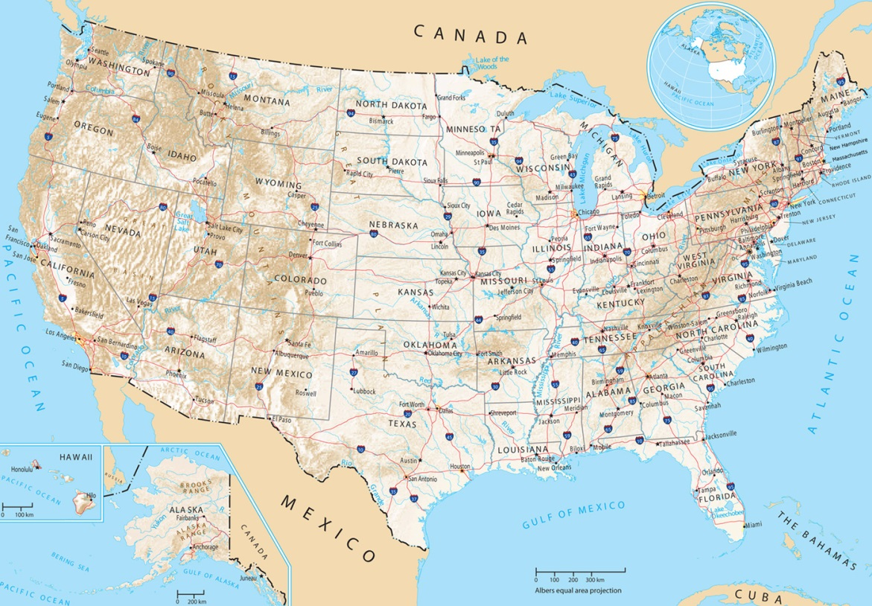
Music of America
New York City George Gershwin
Washington D.C.
John Philip Sousa
Nashville,
Tennessee
Jay Ungar and Molly Mason
Los Angeles & Hollywood, California
Carl Stalling
Texarkana, Arkansas
Scott Joplin
How does music around America sound?
– the same – or different from each area

Slide 3
When Did These Composers Live?
1850
1900
1950
2000
Sousa
1854 1932
Joplin
1867 1917
Gershwin
1898 1937
Williams
1932
Ungar & Mason
1940’s
Sousa and Williams wrote big music for bands and orchestra
to entertain at concerts and in movies.
The music of Joplin, Gershwin and Unger/Mason connects
to old-time American folk tunes and dance rhythms.

Slide 4
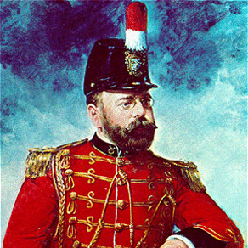
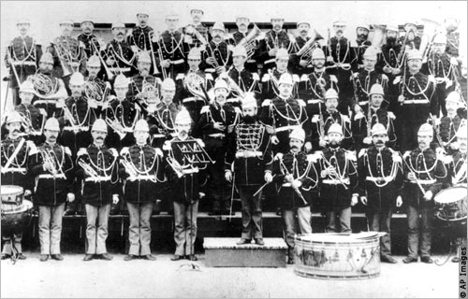
John Philip Sousa
Sousa wrote 136 marches for marching bands in parades and concerts. They also made ragtime music popular.
Stars and Stripes Forever
- National March of U.S.A.
Semper Fidelis
- March of the U.S. Marine Corps
U.S. Field Artillery
- Became The Army Goes Rolling Along,
U.S. Army official song
The Washington Post
- Theme for TV’s Monty Python’s Flying
Circus
The Sousa band toured the world for 40 years.

Slide 5
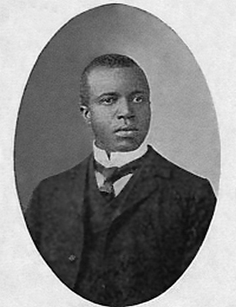
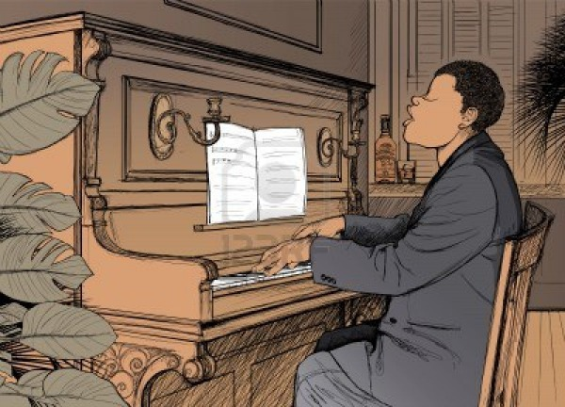
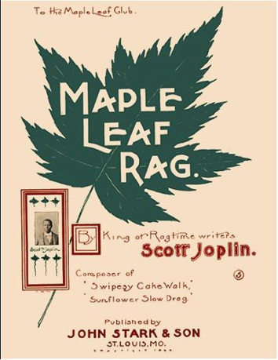
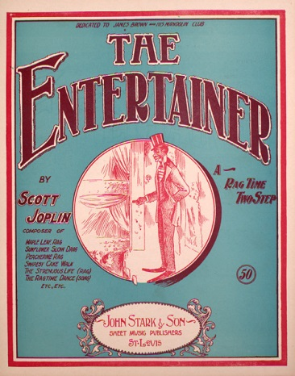
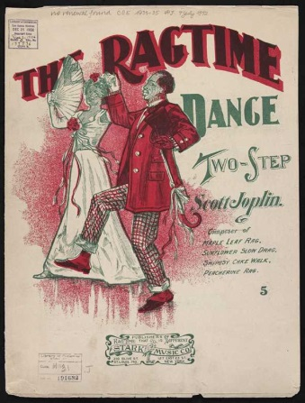
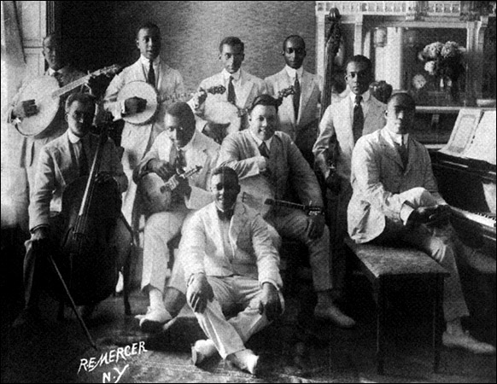
Scott Joplin
‘King of Ragtime’
Joplin played as a solo pianist and with dance orchestras. They toured from Texas to New York. He wrote many ragtime pieces.
Ragtime music had syncopated
or ‘ragged’ rhythms. It was popular dance music in New Orleans and St. Louis.

Slide 6
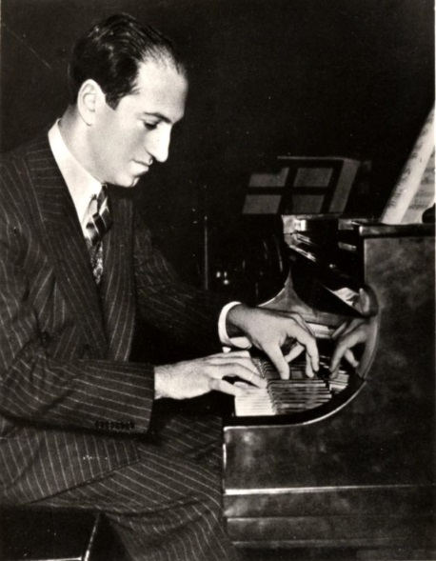
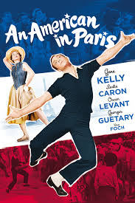
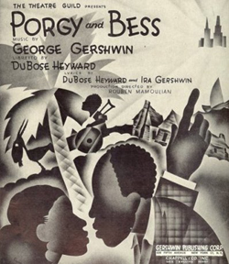
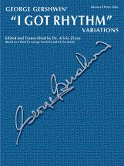
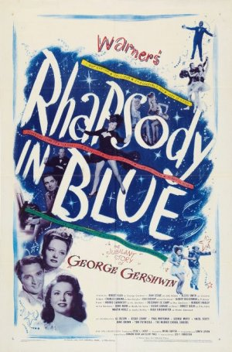
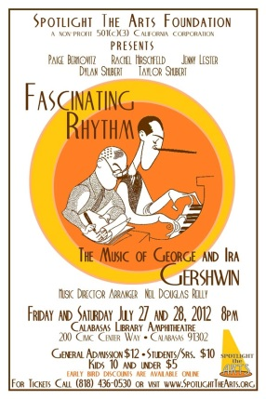
George Gershwin
Trained as a classical pianist
Influenced by composers in Europe
Learned to love ragtime and jazz music
He said, “True music must reflect the thought and aspirations of the people and time. My people are Americans. My time is today.”

Slide 7
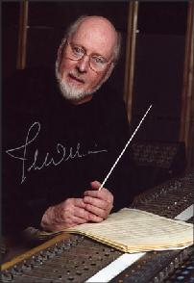
John Williams
Award winner for film scores
Studied classical music
Played jazz piano in bands
Conducted and arranged
music in the U.S. Air Force
♬ Composed for concerts
and movies
JAWS

E. T.
Conductor of the
Boston Pops for 13 years
Star Wars
Superman
A ‘neo-Romantic’ composer because his pieces have long, flowing melodies and are arranged for big orchestras (similar to the Romantic Period – late 1800’s).
His themes often represent a person, setting or idea in a movie, such as the SuperMan theme.
Raiders of the Lost Ark
Close Encounters
of the Third Kind

Slide 8
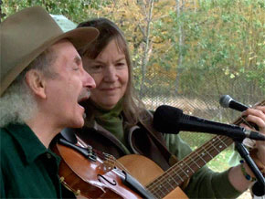
Jay Ungar & Molly Mason
Part of the folk music scene in the 60’s and 70’s.
Play American fiddle and bass acoustic guitar.
They play music of the people and popularize its sound:
by playing it on radio shows and
by creating film scores using the music of the period.
  Ashokan Farewell, the theme for PBS miniseries Civil War
Folk music continues to live because it is performed and its themes and sounds are used in new works.

Slide 9
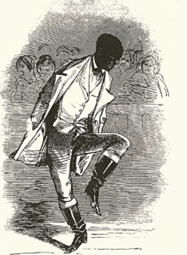
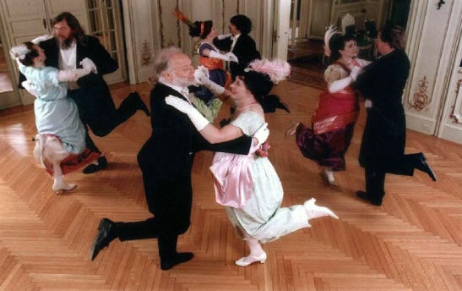
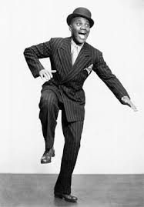
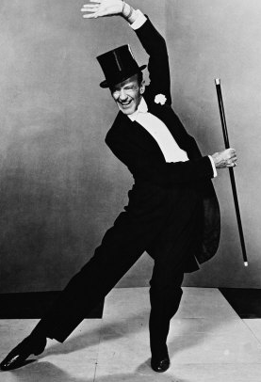
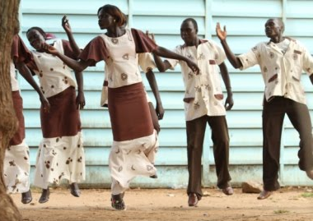
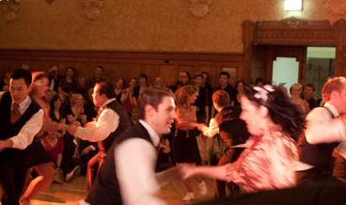
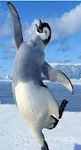
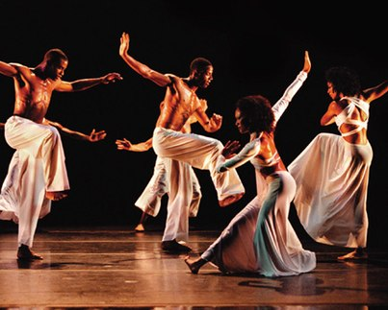
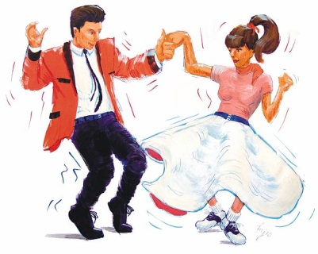
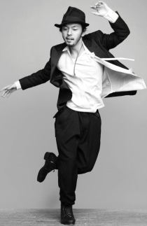
Dance Transforms with the Music
Juba Dancing
from Africa
Free Form Dancing
Social Dancing
Tap Dancing
Theatrical Dancing
Ragtime & Jazz Dancing – 1920’s
Swing Dancing –1940’s
Rock ‘n’ Roll – 1950’s and 1960’s
Modern dance

Slide 10
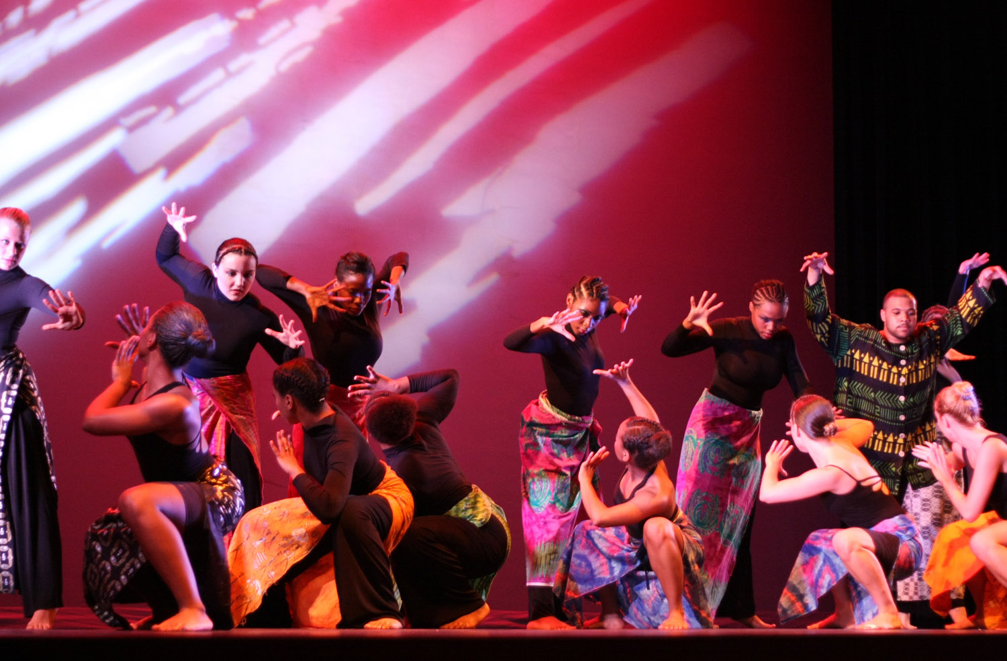
African Dance in Modern Classical Dance
(dancers from the African American Dance Company of Indiana University)
Many groups in America use African dance styles in modern classical dance.

