Slide 1
ASO Rockefeller String Quartet
presents
Story Time
Arkansas
Learning through the Arts

Slide 2
What makes up a Story?
Setting
PLOT:
Beginning (or Introduction)
Middle (Conflict or Problem
End (Resolution)
Mood
Characters
Tone

Slide 3
Settings: An Event
Name 4 things that are happening!

Slide 4
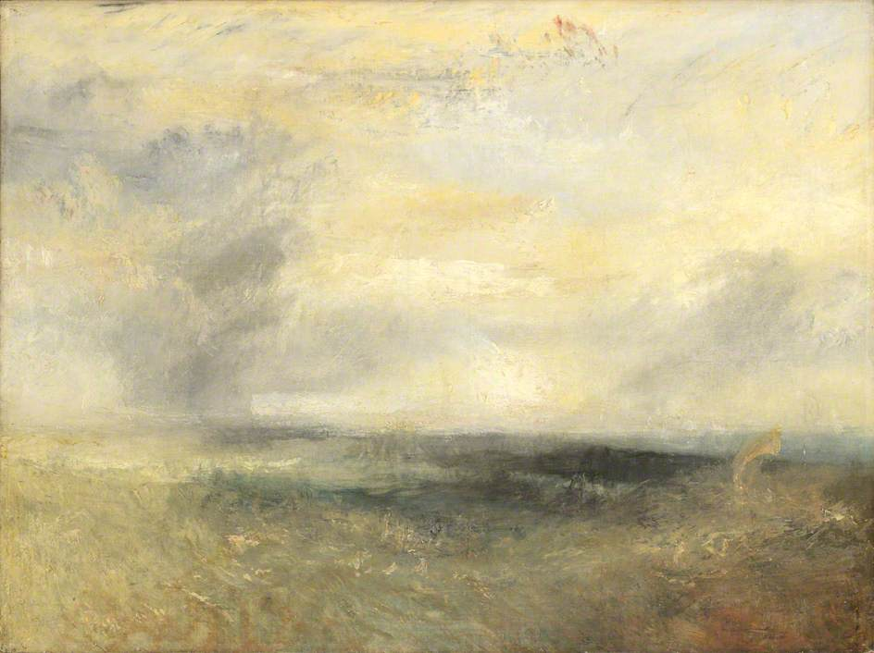
Settings: A Hazy Day
Margate from the Sea by J.M.W. Turner (painted between 1835 and 1840)
What images is the painter creating?

Slide 5
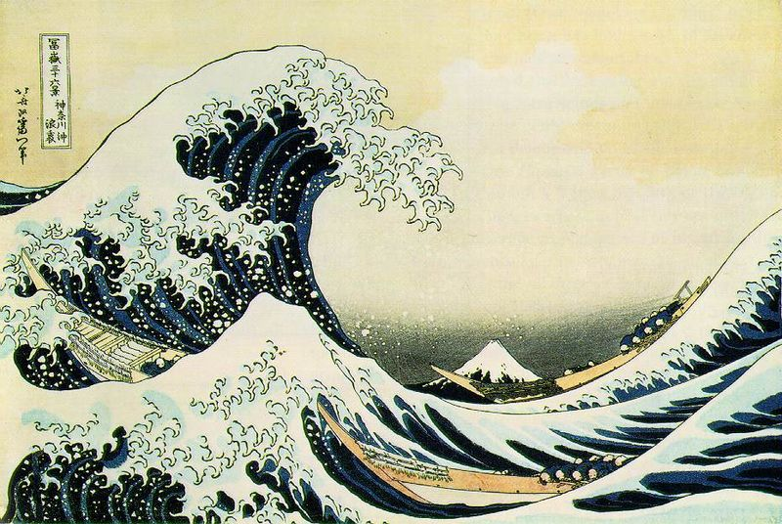
Settings: A Risky Day?
Tsunami by Katsushika Hokusai, created between 1829 and 1832
Name 4 things that are happening!

Slide 6
Who are the Characters?
Friends
Girls
pets
Their enemies
wild animals
Boys
A tree
Parents
Helpers
Name your characters and
What four adjectives describes them?

Slide 7
What are the Parts of the Plot?
Beginning: Once upon a time. . . . . . . . .
(Create setting, tone and mood)
Middle: Next, a problem or conflict happens
(Describe the problem, maybe changing setting, tone and mood)
Then, the problem may become worse
or more complicated.
(Describe the complication. Does the setting, tone or mood change.)
End: Finally, the problem resolves one way or another.
(Has the setting, mood and tone changed again?
What happens to the characters?)
Are you ready to write your story?

Slide 8
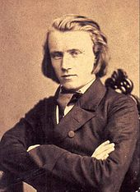
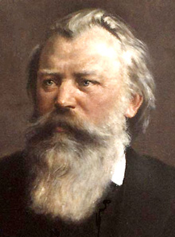
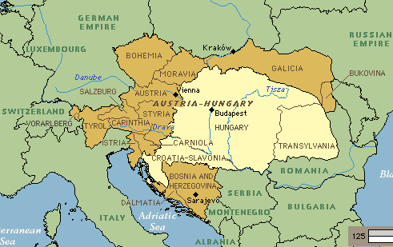
Johannes Brahms, Romantic composer (1833 – 1897)
Born in Germany
Lived in Vienna, Austria
Visited Hungary and loved their folk music.

Slide 9
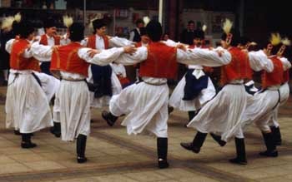
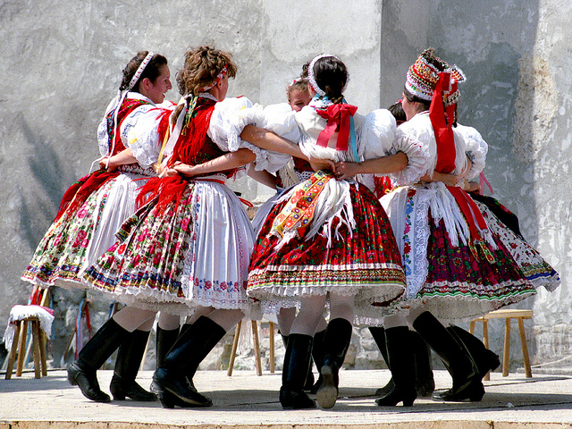
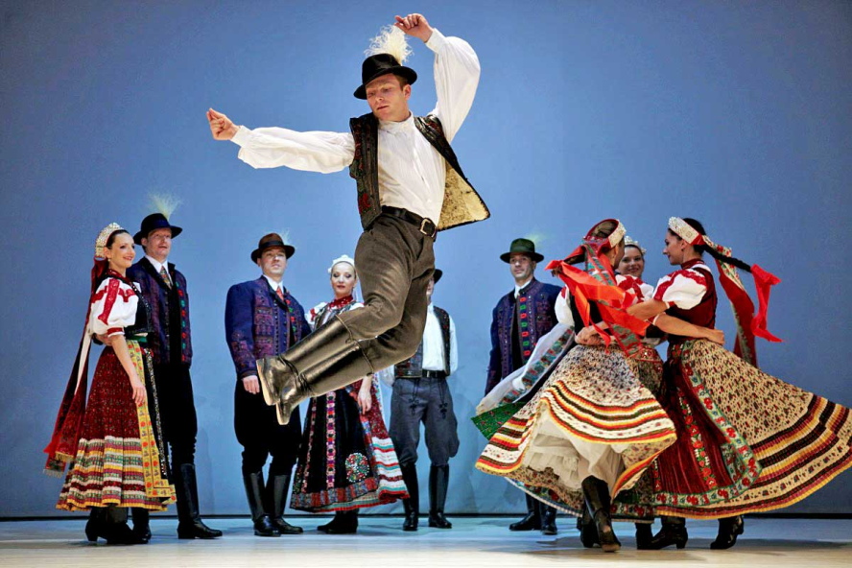
Hungarian Dancing
Brahms loved their folk
music and dances.
He heard strong rhythms,
and lively melodies.
Describe these dancers.

Slide 10
Hungarian Dance #5 by Johannes Brahms
Brahms wrote 21 Hungarian Dances.
They were short and very popular.
Dance #5 seems to have a:
Beginning lively melodies in the violins
Middle slow/fast in the strings (01:32)
End return to beginning melodies (02:22)
Listen again to a full orchestra play the piece.
(YouTube, by the Hungarian Symphony Orchestra, Budapest, 03:46)
Does the music make you think of a story?

Slide 11
WRITE YOUR OWN STORY!
Setting
PLOT:
Beginning (or Introduction)
Middle (Conflict or Problem)
End (Resolution)
Mood
Characters
Tone

